Slide 1
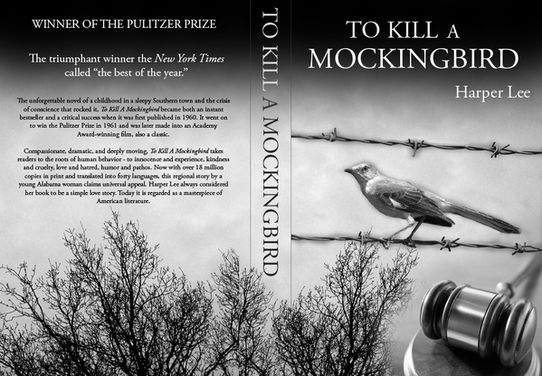
Parts of an Essay
ELA
Mr. DiDonato

Slide 2
Agenda
Outline & Checklist
Introduction
Specifics (Hook, Theme, Thesis & Forecast)
Examples
Body
Topic Sentence
Support/Evidence
Analysis/Commentary
Conclusion

Slide 3
Essay Outline & Checklist
Outline Checklist:
There are several vital elements to any successful essay. Those elements are listed below. Following this format will help you keep your thoughts organized and get your essay underway.
Essay Elements Definitions:
Introduction: General background info about topic, reason for reader to be interested (hook), theme/thesis statement and forecast:
Paragraph 1:
Topic Sentence
Support + Detail/example/commentary-analysis (x2-3)
Paragraph 2:
Topic Sentence
Support + Detail/example/commentary-analysis (x2-3)
Paragraph 3:
Topic Sentence
Support + Detail/example/commentary-analysis (x2-3)
Concluding Paragraph re-state theme/thesis statement: Summary of main points, return to general context, wrap-up of essay, etc.

Slide 4
1 - Introductory Paragraph
Captures the readers attention
Sets a tone (serious, light, call to action)
Provides general background information
Asserts a thesis/theme
Indicates what is to follow in the main body
Forecast

Slide 5
Opening Sentence
Ideally, the opening sentences of an essay set a tone appropriate to the topic and audience and communicate information that can guide readers toward the purpose of the essay. Sometimes writers begin with an introduction to the general topic (think THEME!) and then narrow the ideas to the more precise topic.
Hook: perhaps use a quote (not Yoda…but of someone significant) – scholars, leaders etc.; or stats, or background information
You want to keep the reader READING! Therefore, avoid mundane clichés:
“Throughout history, there have been conflicts”
…Background information: reference the title, author or characters

Slide 6
Thesis/Theme Statement
A thesis/theme is a clearly worded answer to a question and/or a clearly worded declaration of the view(s)/ideas a writer will substantiate, assert, or prove in a paper. A thesis forecasts and focuses the essay that follows
Rather than simply setting up an essay that reiterates information already familiar to the writer and readers, a strong thesis/theme captures an insight or an approach to a topic that is unique and that is persuasively supported by the evidence and analysis that follow

Slide 7
Thesis/Theme Examples
Prompt: Discuss the changes in the character of Scout in Harper Lee’s To Kill a Mockingbird.
Weak Thesis: In the book To Kill a Mockingbird, by Harper Lee, Scout changes a great deal.
Commentary: The question of how Scout changes—exactly what the changes are—is not addressed by the thesis. While the statement does acknowledge that Scout changes, no indication of precisely how she changes is included. The thesis is overly general—“safe,” but not yet “strong.”

Slide 8
Stronger Thesis/Theme: In Harper Lee’s To Kill a Mockingbird, Scout develops from a naive girl dependent upon the ideas of others to shape her view of the world, to an independent thinking individual with convictions of her own.

Slide 9
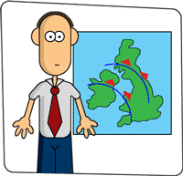
Forecast
A forecast outlines the subtopics of support that will follow in the essay and does so in the order in which they appear.
Forecasts need not be overly detailed or cumbersome. They should simply notify readers of what lies ahead in a concise and manageable statement.

Slide 10
Example
An essay proving the claim of Scout’s development in To Kill a Mockingbird, as mentioned earlier, might follow the thesis with a forecast something like:
Scout’s encounters with Tom Robinson, experiences with Boo Radley, and her ongoing conversations with her father allow her to exchange curiosity for conviction.

Slide 11
Opening Paragraph Exemplar
The atmosphere of racism and hatred of many southern states in the 1930s, provides the framework for Harper Lee’s classic novel To Kill a Mockingbird. As the narrator, and protagonist, Scout develops from a naive girl dependent upon the ideas of others to shape her view of the world, to an independent thinking individual with convictions of her own. When Scout learns of the injustice encountered by Tom Robinson, she begins her journey towards maturity. Later, after multiple interactions with the misunderstood Boo Radley, Scout learns some important lessons about understanding and acceptance. Moreover, her ongoing conversations with her father allow her to exchange the curiosity of an innocent child, for the convictions of a maturing young woman.
Intro
Theme Hook
Thesis
Forecast

Slide 12
2 – Essay Body
The paragraphs in the body of an essay develop a convincing case to prove the claim advanced in the thesis. The body of an essay explores the ideas relevant to the thesis; evidence is presented in a logical fashion and is interpreted in ways that clearly support the thesis. In addition, the body of an essay must continuously remind readers of the thesis and solidify/intensify the insight/philosophical premise set forth without simply repeating it.

Slide 13
Topic Sentence
The topic sentence of each paragraph of the body of an essay introduces some element of the thesis that will become the subject of the paragraph. Topic sentences can draw on the thesis and/or the forecast ideas and wording to keep the central argument of the paper actively in play for readers. Rather than simply repeating the thesis or forecast, strong topic sentences develop an aspect of the thesis or forecast that will be further expanded in the paragraph.

Slide 14
Example
A topic sentence that might follow the To Kill a Mockingbird thesis and forecast mentioned earlier might be:
Because she is a child, it is not surprising that Scout is naive about the world and depends upon the ideas of others to shape her views about people and events.
This topic sentence addresses the first portion of the thesis—Scout’s naiveté and dependence on the ideas of others—and sets up a paragraph of foundation, one intended to establish
Scout’s character before she begins to change

Slide 15
Other topic sentences for this particular paper might introduce the change prompted by her encounters with Tom Robinson, the growth in Scout that results from her encounters with Boo Radley, and her growth as apparent through her conversations with her father.

Slide 16
Analysis/Commentary
The analysis or commentary that follows the evidence extends the idea and gives readers the time to absorb the idea, it also helps to prove the evidence more completely:
Because she is a child, it is not surprising that Scout is naive about the world and depends upon the ideas of others to shape her views about people and events. Children are often sheltered from the world by their parents and tend to see events through their parents’ eyes. Scout’s early knowledge of people in the small town of Maycomb comes from her father, Atticus.

Slide 17
Support/Evidence
Like the evidence presented in a legal case, the evidence presented in an essay should be persuasive; it should persuade readers that the writer’s point of view is worth considering. Every bit of evidence in an essay should point toward the validity of the thesis:
Quotes
Details from the book: plot, characterization, figurative language, setting and style
References to familiar aspects of cultural norms or politics or beliefs
Facts, ideas from critical sources and first hand observations will play a role in some of your future essays!

Slide 18
Conclusion
The conclusion of an essay should bring the writer and readers back into accord about what the essay set out to prove and reemphasize the value of the argument. Whether in one or more paragraphs, readers often anticipate the following elements in a conclusion:
Summary (more than just a retelling of the thesis statement!)
Insight (deepens the significance of the thesis statement; avoid clichés)
Does NOT introduce a new topic or idea!
Reminds the reader of the value of the essay…

Slide 19
Example
Because she grows from her experiences, Scout develops convictions that establish her as an independent thinking individual. The trial of Tom Robinson, the emergence of Boo Radley, and her close relationship with Atticus all teach her the value of making up her own mind about the character and motivations of the people around her. As Scout herself demonstrates, independent thought is the only counterbalance to the unfortunate tendency of individuals to prejudge others.

Slide 20
Good Luck!

